Slide 1
Compensation and Benefits
MBA201

Slide 2
Compensation and Benefits:
Introduction, Definitions,
Total Compensation,
Total Rewards System,
Forms of Pay,
External and Internal Factors, Establishing Pay Rates, Employee Benefits.
Industrial Relations: Meaning of IR, IR approaches, maintaining good human and industrial relations -Discipline management, Grievance Management, Collective Bargaining, Workers participation in management, Industrial disputes Management, brief overview of labour legislations in India to maintain industrial relations.

Slide 3
Industrial Relations:
Meaning of IR,
IR approaches,
maintaining good human and industrial relations -Discipline management,
Grievance Management,
Collective Bargaining,
Workers participation in management, Industrial disputes Management,
brief overview of labour legislations in India to maintain industrial relations.

Slide 4
Introduction, Definitions
All forms of pay or rewards given to employees and arising from their employment.
There are direct financial payments: Basic wages, Allowances, Incentives, Commissions, Perquisites / fringe benefits, Bonuses etc.
There are Indirect payments in the form of financial benefits:
Employer paid insurance or
Paid leave/holiday
PF and Gratuity
Compensation is a systematic approach to providing monetary value to employees in exchange for work performed.
Compensation management is a process of determining cost effective pay structure, designed to attract, retain, provide an incentive to work hard, and structured to ensure that pay levels are perceived as fair.

Slide 5
TOTAL COMPENSATION
TC = (BP + AP + IP) + (WP + PP) + (OA + OG) + (PI + QL) + X
    TC = total compensation
    BP = base pay, or salary
    AP = augmented pay, that is, any one-time payment, even if received at regular intervals (such as overtime)
    IP = indirect pay (benefits)
    WP = works-pay, that is, employer-subsidized equipment, uniforms, and so on
    PP = perks-pay, that is, special benefits-anything from accessories to employee discounts on company products
    OA = opportunity for advancement and increased responsibility
    OG = opportunity for growth, both through on-the-job training and through off-site training and degree attainment
    PI = psychic income, the emotional enhancements provided by the job itself and the setting (the people) QL = quality of life, that is, opportunity to express other important aspects of life (location close to home, flextime, on-site child care, ski to work, or whatever)
    X = any unique element that an employee wants that the workplace can facilitate ("Can I bring my dog to work?")

Slide 6
TOTAL COMPENSATION
  According to experts this deepening of the import of compensation has occurred due to certain issues with compensation:
    Obsolescence: with significant shifts in workplaces like changes in workforce profiles, expectations, flatter organization structures, the existing systems of narrow pay ranges, rewarding traditional values, over reliance on cash incentives are some of the symbols of an outmoded system.
    Changes in psychological contract: the old contract of ‘if you work hard, the firm will take care of you ‘has been replaced by ‘if we outperform the market, we shall share the rewards’.
    Lack of alignment with business strategies.
    Gap between espoused theories and theories in action.
    Double standards displayed by senior leadership .

Slide 7
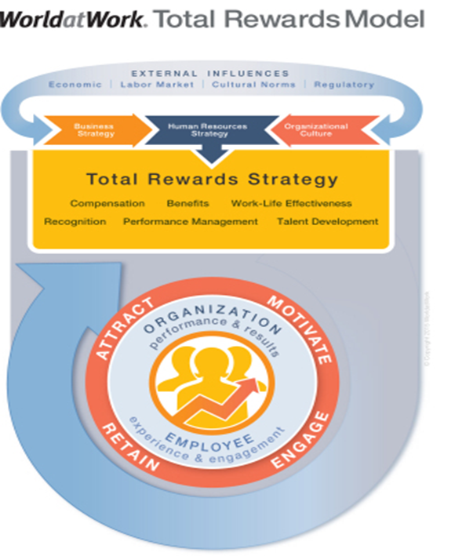
TOTAL REWARDS SYSTEM
TOTAL REWARDS
  It integrates the financial and non financial elements of rewards into a unified whole
  The WorldatWork Total Rewards Model, depicts the strategic elements of the employer-employee exchange, and indicates how external influences and an increasingly global business environment affect ‘attraction, motivation, retention and engagement’ of employees

Slide 8
TOTAL REWARDS – WORLDatWORK MODEL
  The WorldatWork Model represent 6 elements of total rewards that collectively define an organization's strategy to attract, motivate, retain and engage employees:
Compensation: Pay provided by an employer to its employees for services rendered (i.e., time, effort, skill). This includes both fixed and variable pay tied to performance levels.
Benefits: Programs an employer uses to supplement the cash compensation employees receive. These health, income protection, savings and retirement programs provide security for employees and their families.
Work-Life Effectiveness: A specific set of organizational practices, policies and programs, plus a philosophy that actively supports efforts to help employees achieve success at both work and home.
Recognition: Either formal or informal programs that acknowledge or give special attention to employee actions, efforts, behavior or performance and support business strategy by reinforcing behaviors (e.g., extraordinary accomplishments) that contribute to organizational success.
Performance management: The alignment of organizational, team and individual efforts toward the achievement of business goals and organizational success. Performance management includes establishing expectations, skill demonstration, assessment, feedback and continuous improvement.
Talent development and career opportunities: Provides the opportunity and tools for employees to advance their skills and competencies in both their short- and long-term careers

Slide 9
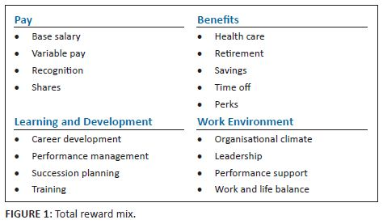

Slide 10
FORMS OF PAY
BASIC PAY
VARIABLE PAY
  Company Performance Linked Pay
  Group/Team Performance Linked Pay
  Individual Performance Linked Pay
FRINGE BENEFITS
PERQUISITES
ALLOWANCES

Slide 11
Theories of compensation
REINFORCEMENT AND EXPECTANCY THEORY
  THORNDIKE’S LAW OF EFFECT
  VROOM’S EXPECTANCY THEORY
EQUITY THEORY
AGENCY THEORY

Slide 12
Reinforcement Theory
Similar to goal-setting theory, but focused on a behavioral approach rather than a cognitive one.
  Behavior is environmentally caused
  Thought (internal cognitive event) is not important
    Feelings, attitudes, and expectations are ignored
  Behavior is controlled by its consequences – reinforcers
  Is not a motivational theory but a means of analysis of behavior
  Reinforcement strongly influences behavior but is not likely to be the sole cause

Slide 13
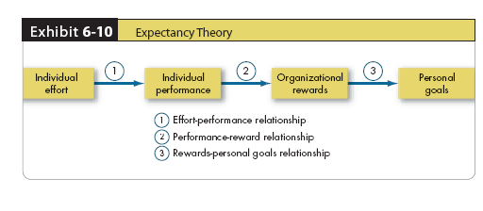
Vroom’s Expectancy Theory
The strength of a tendency to act in a certain way depends on the strength of an expectation that the act will be followed by a given outcome and on the attractiveness of the outcome to the individual.
Expectancy of performance success
Instrumentality of success in getting reward
Valuation of the reward in employee’s eyes

Slide 14
Adams’ Equity Theory
Employees compare their ratios of outcomes-to-inputs of relevant others.
  When ratios are equal: state of equity exists – there is no tension as the situation is considered fair
  When ratios are unequal: tension exists due to unfairness
    Under-rewarded states cause anger
    Over-rewarded states cause guilt
  Tension motivates people to act to bring their situation into equity

Slide 15
Adams’ Equity Theory
  TYPES OF EQUITY
    EXTERNAL EQUITY – External equity denotes employee perception of fairness while comparing with the wages prevailing in external labour markets
    INTERNAL EQUITY – Internal equity exists when the employees perceive that the wages are commensurate with the relative internal value of each job
    INDIVIDUAL EQUITY – When individuals who on similar jobs are compensated on the basis of variations in individual performance, in so-called pay for performance, individual equity occurs
    PERSONAL EQUITY – Personal equity involves no direct comparison between employees. It exists when the compensation that an employee receives, matches an employee's own image of his or her worth
    PROCEDURAL EQUITY – It refers to the perceived fairness of the processes and procedures used to make decisions regarding the allocation of pay

Slide 16
Reactions to Inequity
Employee behaviors to create equity:
  Change inputs (slack off)
  Change outcomes (increase output)
  Distort/change perceptions of self
  Distort/change perceptions of others
  Choose a different referent person
  Leave the field (quit the job)
Propositions relating to inequitable pay:
  Paid by time:
    Overrewarded employees produce more
    Underrewarded employees produce less with low quality
  Paid by quality:
    Overrewarded employees give higher quality
    Underrewarded employees make more of low quality

Slide 17
Equity Theory’s “Relevant Others”
There can be four referent comparisons:
  Self–Inside
    The person’s experience in a different job in the same organization
  Self–Outside
    The person’s experience in a different job in a different organization
  Other–Inside
    Another individual or group within the organization
  Other–Outside
    Another individual or group outside of the organization

Slide 18
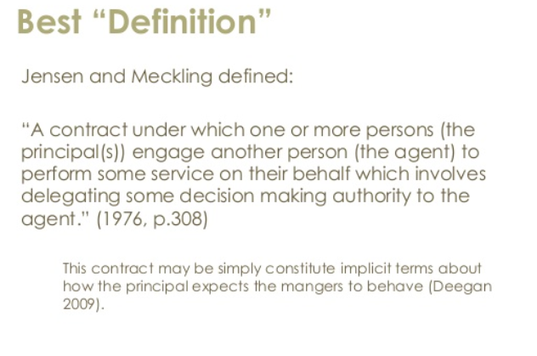
agency THEORY

Slide 19
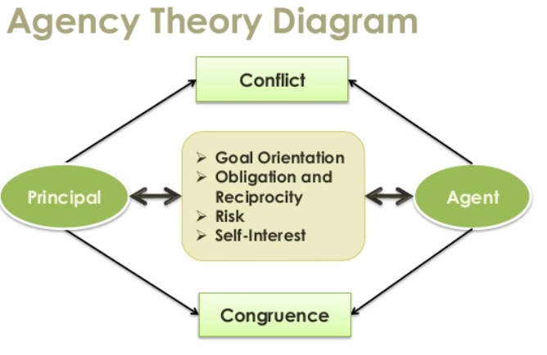
agency THEORY

Slide 20
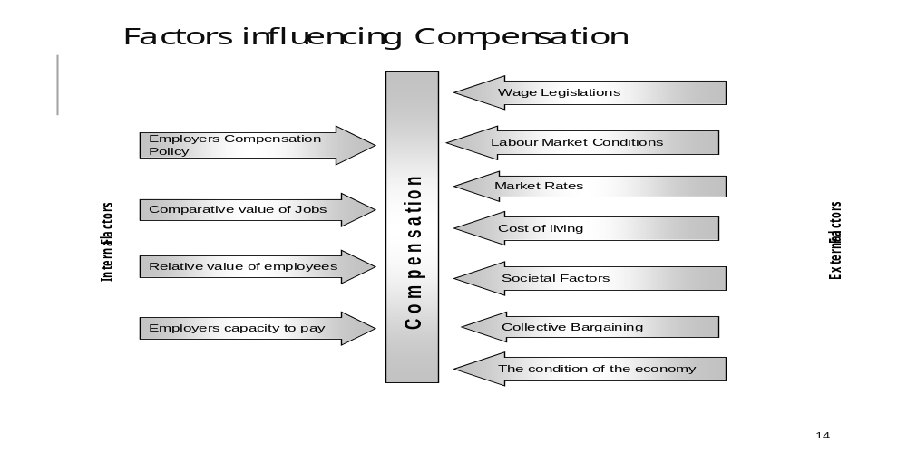
Factors influencing compensation

Slide 21
Establishing pay rates
There are several steps to designing a pay structure
Collect and summarize work content information for each job through Job Analysis.
Establish relative worth of different jobs through Job Evaluation.
Gather Compensation data from other employers for comparable jobs through Salary survey.
Formulate the Compensation policy in respect of external competitiveness.
Integrate the internal structure (Step 2) with the external market pay rates and create a Compensation structure.

Slide 22
Employee Benefits
  Employee Benefits (also covering fringe benefits, perquisites, or perks) constitute the indirect financial and non financial remuneration, which an employee is eligible to receive in addition to their normal wages or salaries, by virtue of being employed.
  The objective of employee benefits is to address the economic security concerns of the employees, and while doing so, to improve employee retention in the organization.

Slide 23
Employee Benefits
  Benefits include:
    Housing accommodation
    Accident insurance
    Retirement benefits
    Crèche
    Scholarships
    Educational assistance
    Various kinds of leave
    Leave Fare assistance
    Social security
    Profit sharing, and such specialized benefits

Slide 24
Components of Employee Benefits
Employee benefits have two major components:
Allowances
Allowances include Dearness Allowance, Compensatory allowances (City Compensatory, Hill allowance, duty allowance, Hardship allowance, Shift allowance, and Hazard allowance), Conveyance allowance, House Rent allowance, Deputation allowance, Education allowance etc.
2. Perquisites.
Perquisites include Leave Travel concession, Advances, Soft Furnishing reimbursements, Club membership, and Expense account etc.

Slide 25
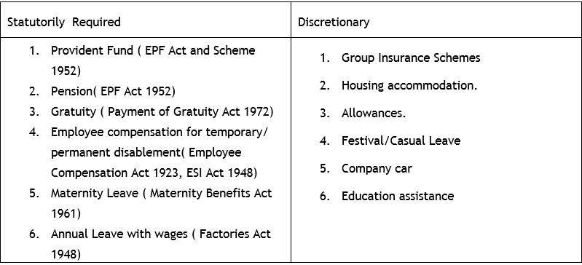
Components of Employee Benefits - INDIA

Slide 26
Industrial Relations

Slide 27
Decent Workplace
People are gainfully employed (and there exist adequate income and employment opportunities);
Social protection system (Labour protection and social security) is fully developed and accessible to all;
Social dialogue and tri-partism are promoted and encouraged; and
Rights at work, as specified in ILO Declaration on Fundamental principles and Rights at Work and Core ILO Conventions, are practiced, promoted and respected.

Slide 28
International Labor Organisation,
The concept of social dialogue covers all types of negotiation, consultation or exchange of information between or amongst representatives of governments, employers and workers on issues of common interest relating to economic and social policy. The underlying principle of social dialogue is that “management by agreement is preferable to management by Diktat. Negotiation is more democratic than unilateral imposition. Hence collective bargaining and social dialogue are the most appropriate means of regulating employment relations, a principle which has been widely reasserted in the current crisis”.
ILO Working Paper No 11. 2010)

Slide 29
Industrial Relations
According to Encyclopedia Britannica, industrial relations denote “the relations of the state with employers, workers, and other organizations. The subject, therefore, includes individual relations and joint consultation between employers and workers at their places of work, collective relations between employers and trade unions; and the part played by the State in regulating these relations”.
Dale Yoder (Personnel Management and Industrial Relations. Prentice Hall. 1942) considers IR to be “a designation of a whole field of relationship that exists because of the necessary collaboration of men and women in the employment processes of Industry”.
According to Armstrong Ir is “concerned with the systems and procedures used by unions and employers to determine the reward for effort and other conditions of employment, to protect the interests of the employed and their employers and to regulate the ways in which employers treat their employees”(Human Resource Management. Kogan Page)

Slide 30
Objectives of industrial relations
No. of Strikes & lockouts and their intensity - man days / man-hours lost & production loss during last five years.
Productivity improvement initiatives and result achieved.
Welfare measures and CSR activities launched by the company.
Training/re-training and skill development initiatives taken by the company for employee's development.
Number of Industrial Disputes pending.
Information about grievance machinery set up by the management at various levels for redressal of genuine grievances of workers.
Whether Works Committees have been set up: if so, details about their composition, functioning and settlement of issues referred to it.
Voluntary welfare measures initiated by the company.
Whether the company has initiated steps towards involving workers' in various decision making process.
Formal as well as informal forums & number of committees.
The system of communication adopted with employees & its relevance in the industrial relations.
Employee retention rate during the last 5 years.

Slide 31
Approaches to industrial relations
Unitarist approach
Systems approach
Oxford approach
Sociology approach.
Marxist approach
Pluralist approach
Gandhian Approach
Strategic Choice Model.

Slide 32

The role of government in industrial relations
Role | Task
An employer in its own right | set the standards of responsible employment practice
A regulator of incomes and prices | control prices and wages, either through direct intervention or in its management of the economy
An economic manager | Formulate Macro-economic policies of the State which affect labour market demand, employment and manpower utilization
a protector of standards | it establishes and monitors minimum standards through its agencies
a rule-maker and legislator | Enacting legislation to create auxiliary, restrictive and regulatory rules that affect the other parties in employment relations.
a promoter of social citizenship guidelines | The extension of political citizenship rights to the workplace through legislation and policy.

Slide 33
The decline of trade unions
In line with a global trend, researchers found a drop in the number of unions submitting annual "returns" to the central government.
In West Bengal, for example, during the period 1982-90 prior to liberalization , 4,380 new unions with a total membership of 629,151 were registered; but in the subsequent nine years post liberalisation, , the number shrank to 2,686 with 240,624 new members .
Regarding the causes for the decline, there is a view that innovative HRM practices pose a threat to trade unions in four ways;
  The individualization of employment contract,
  The demise of union representation,
  The intensification of work and
  Undermining of union solidarity through organizational commitment ..

Slide 34
HRM with union consent
Bluestone and Bluestone has suggested a three track system to classify the different kinds of union- HRM interface existing in different organizations.
Track 1 captures the traditional combative relations over common workplace issues;
Track 2 describes participation of the individual employees in such workplace decision making activities.
Track 3 there is a direct union involvement in a number of issues. According to Blackstone, the Track 3 model compels the union to adopt joint responsibility for quality and partnership, and thereby its adversarial role gets seriously undermined.

Slide 35
Indian scene: Coexistence of IR and HRM?
The tightly drawn frontiers between HRM and IR needs to melt and IR thinking would need to change to become strategic. Two-way communication, training and motivation of individual employees are irreversible processes.
But the bottleneck appears to be in workplace flexibility (functional, working time, types of contracts, workforce size), job design and pay systems, where traditional IR and HRM are bound to lock horns.

